Slide 1
BORN MECHANICAL AND ID INTEGRATION 24TH JULY13

Slide 2
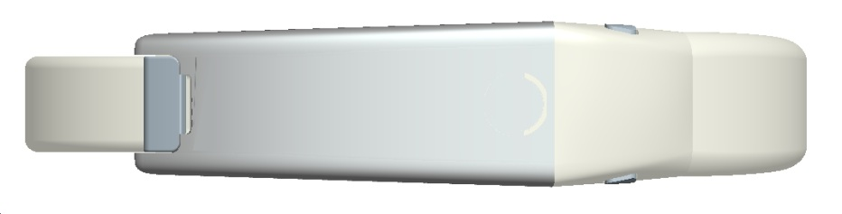
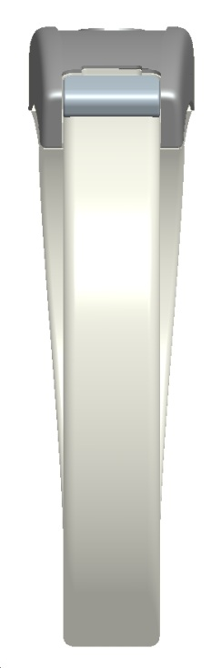
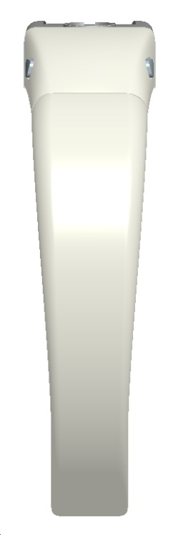
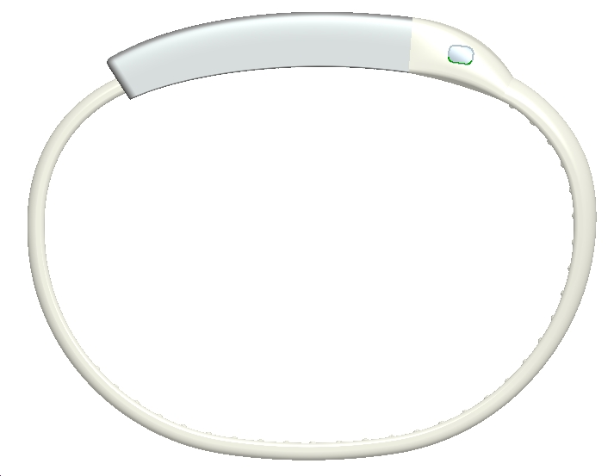
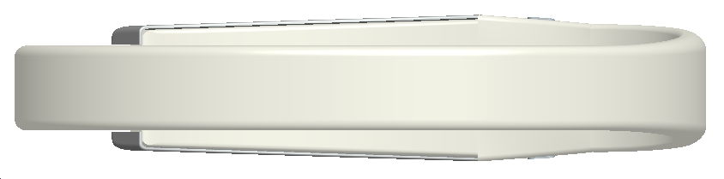
DIMENSION OVERVIEW
3.8mm
11.8mm
13.5mm
METAL COVER
32mm
11mm
USB COVER
BAND
CLIP
6.2mm
RELEASE
CLIPS
5.4mm
SILICONE
BAND
8mm

Slide 3
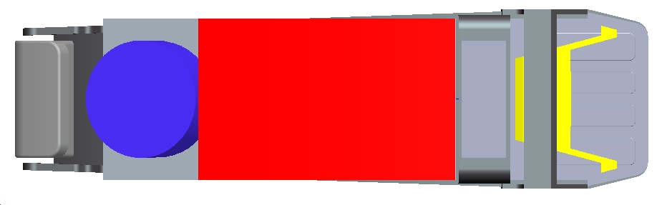
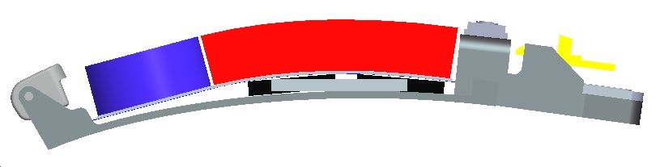
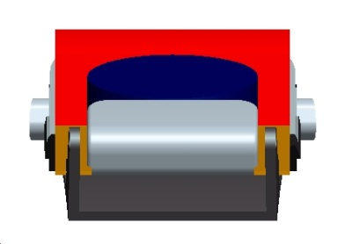
CHASSIS MODULE ASSEMBLY: OVERVIEW OF PARTS
SPRING CLIP
BAND CLIP
USB PCB
CURVED BATTERY
35MAH
LCD &
MICROSWITCH
VIBRATOR
BT ANTENNA
MAIN CHASSIS
DIE CAST ALUMINIUM
RIGD-FLEX PCB
BT CHIPSET

Slide 4
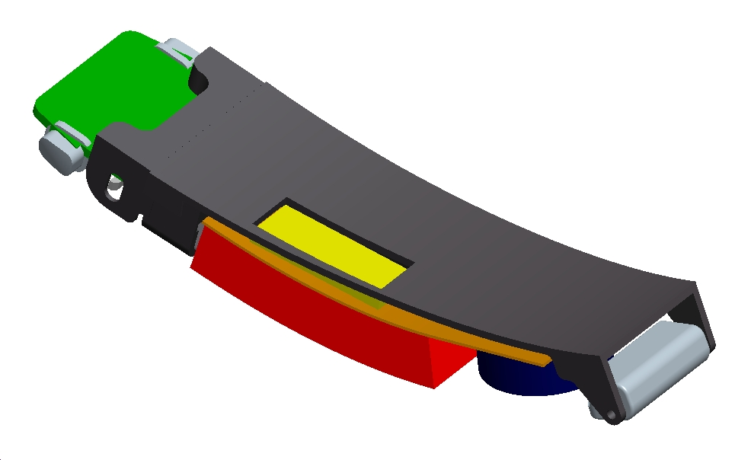
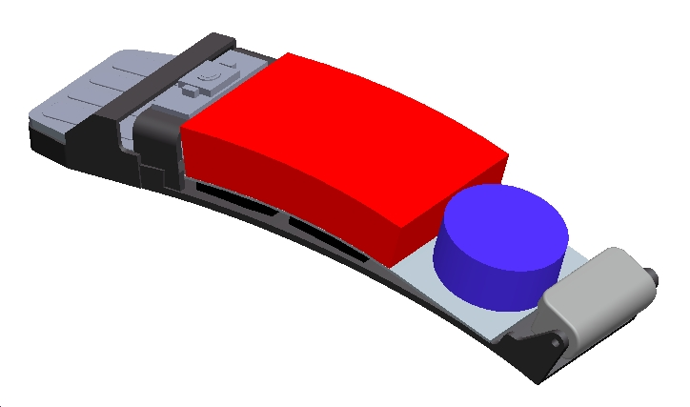
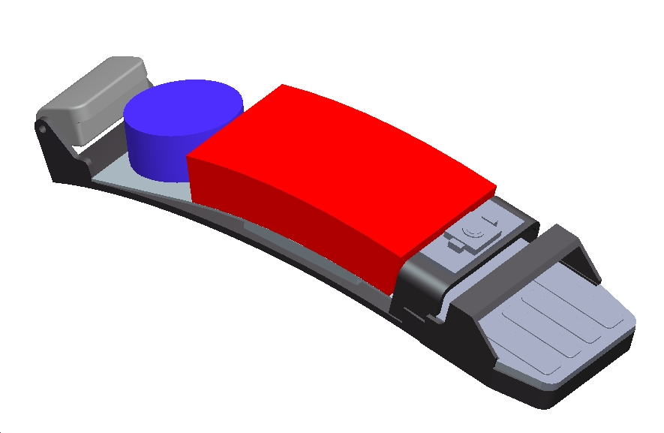
MAIN MODULE ASSEMBLY: FEATURES
MAIN BODY ASSEMBLY
USB PCB+RIGID-FLEX PCB SITS INSIDE THE MAIN CHASSIS (CONNECTED)
PCBA CONNECTS TO BATTERY, VIBRATOR AND MICROSWITCH/LED
CHASSIS MADE FROM MAG ALLOY AND HOLDS THE BAND CLIP IN PLACE
CUTOUT FOR BT ANTENNA IN THE MAIN CHASSIS

Slide 5
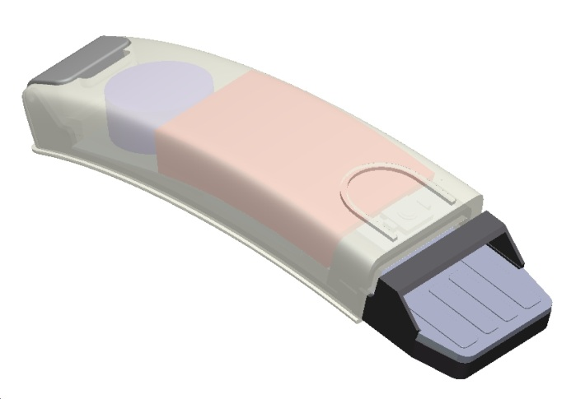
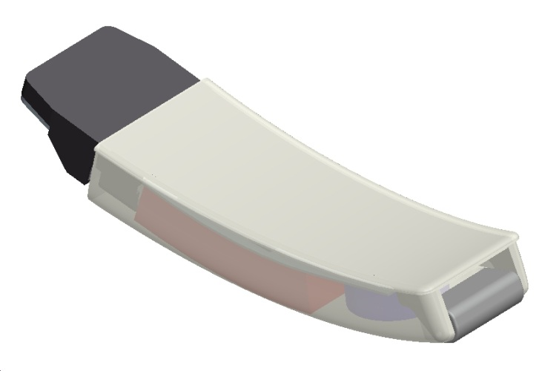
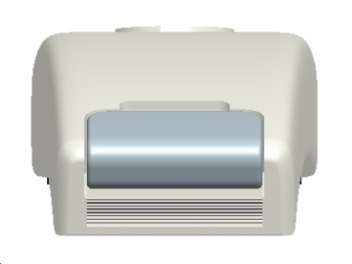
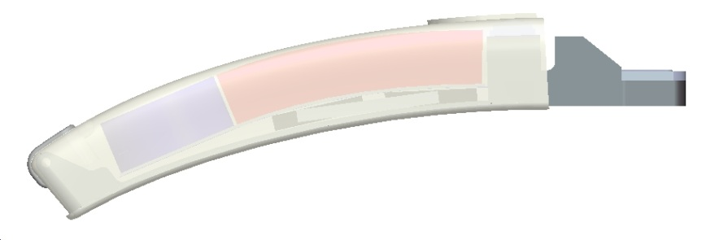
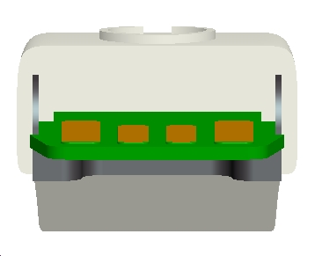
MAIN MODULE ASSEMBLY OVERVIEW
SILICONE OVERMOULD
MAIN BODY ASSEMBLY + OVERMOULD
MAIN BODY ASSEMBLY OVERMOULDED IN SILICONE
USB PCB PROTRUDES OUT WITH THE GUIDE PROVIDED BY THE CHASSIS
COMPLETELY SEALED UNIT IS WATERPROOF
METAL COVER IS THEN PLACED OVER THE TOP – SEE NEXT PAGE
USB IS COMPLETELY SEALED

Slide 6
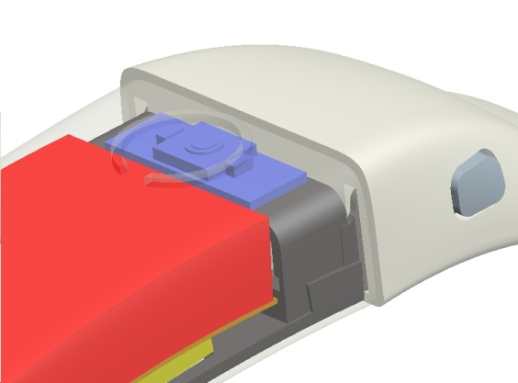
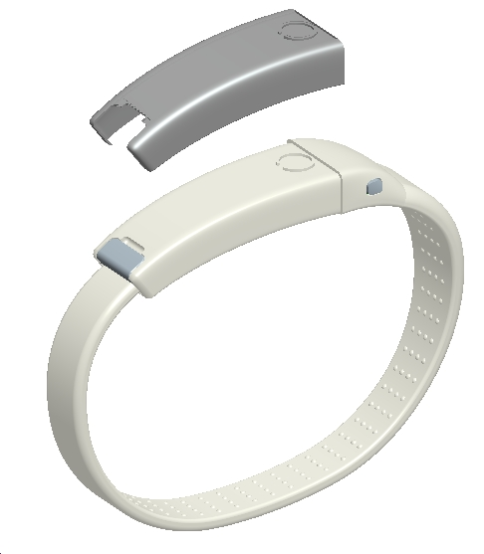
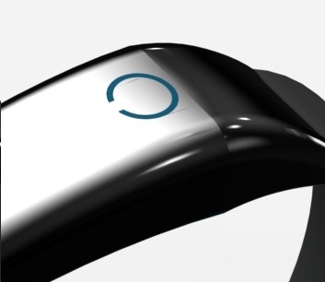
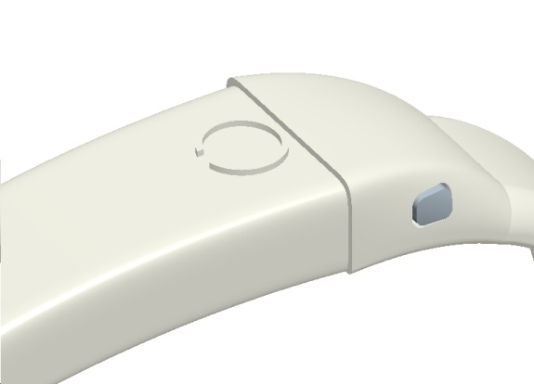
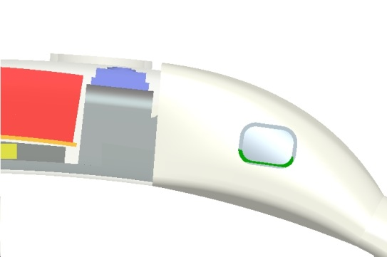
FINAL MODULE ASSEMBLY OVERVIEW
MAIN BODY ASSEMBLY + METAL COVER
PRESSED METAL COVER PLACED OVER THE TOP OF OVERMOULD
PRESSED COVER ALSO INTEGRATES THE BUTTON THAT ACTS AS A LIGHTGUIDE – SEE BELOW
MICRO SWITCH AND LED ARE SEALED BY THE SILICONE OVERMOULD
THE METAL COVERS COULD BE CHANGED BY THE END USER TO DIFFERENT COLOURS AND ALSO FINISHES. IT ALSO PROVIDES A GOOD CHANCE FOR CUSTOM BRANDING OPPORTUNITIES
LED SHINES THROUGH SEMI-
TRANSPARENT SILICONE &
THROUGH THE METAL COVER
MICRO SWITCH UNDER THE
SILICONE OVERMOULD
MICRO SWITCH & LED
SECURED BY CHASSIS

Slide 7
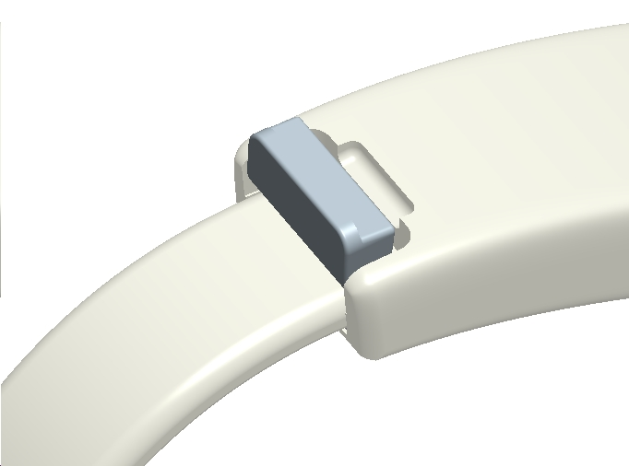
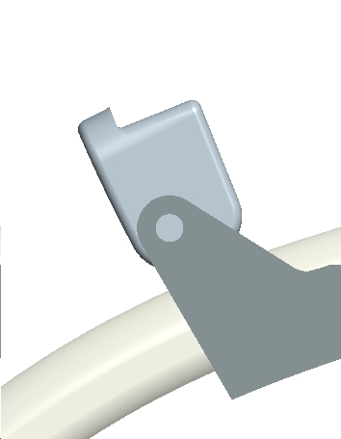
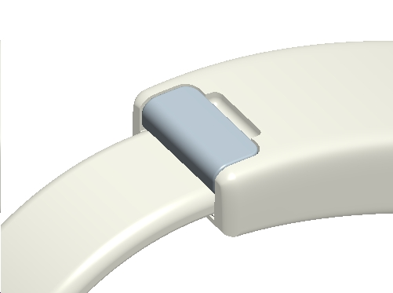
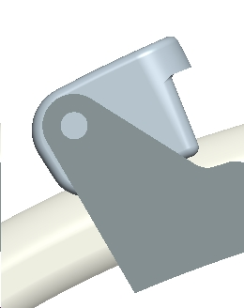
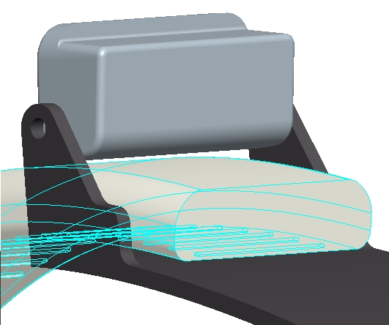
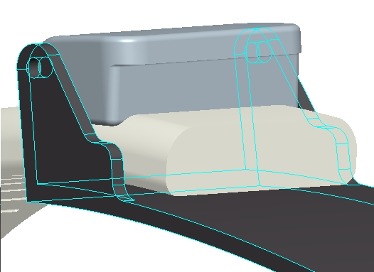
BAND CLIPPING OVERVIEW
BAND CLIP AS PER TAG
SPORT WATCH
CLOSED POSITIION
OPEN POSITIION
OPEN POSITIION
INTERFERENCE FLEXES THE SILICONE BAND & HOLDS IN PLACE
WHEN CLIP OPEN CLEARANCE ENABLES BAND TO GO IN.
BAND IS CUT TO SIZE

Slide 8
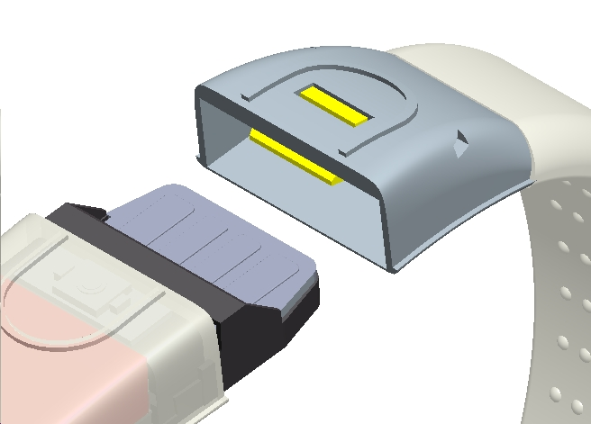
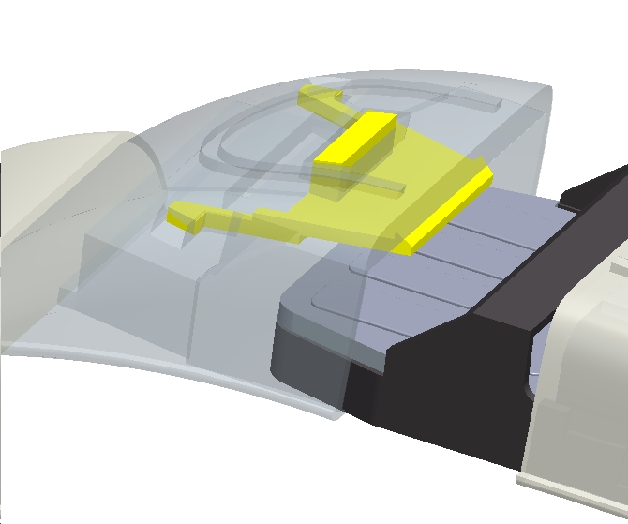
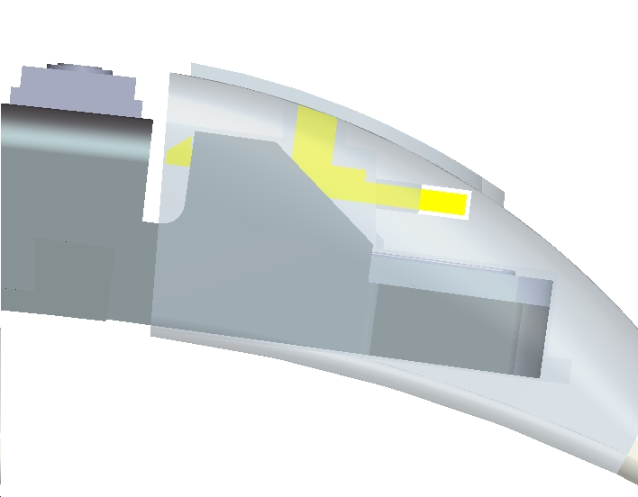
USB COVER & MAIN BODY OVERVIEW
USB COVER HAS CLIP
THAT LOCKS INTO THE CHASSIS FRAME
USB COVER LOCKS ONTO THE METAL CHASSIS
BUTTON PUSHED DOWN ANDLOCKS INTO METAL CHASSIS

Slide 9
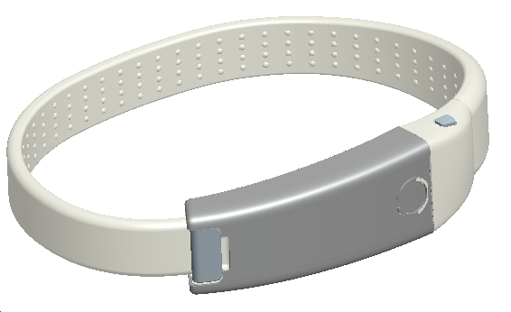
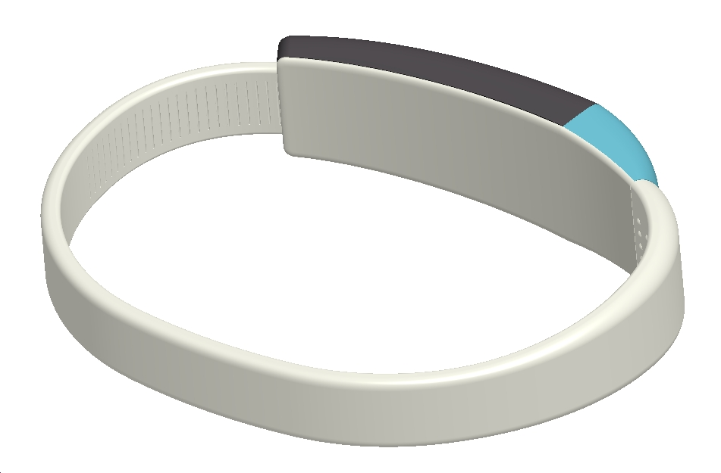
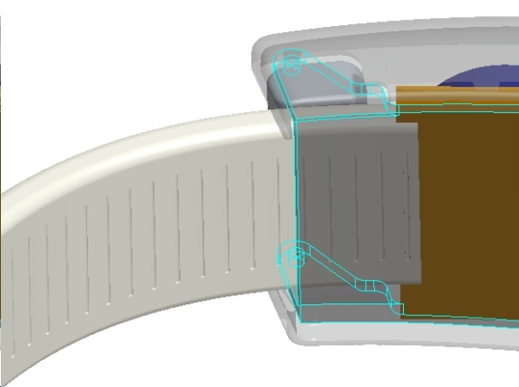
SILICONE BAND OVERVIEW
DIMPLE DETAILS ON INSIDE OF THE SILICONE BAND
SILICONE BAND IS CUT TO
REQUIRED SIZE. CUT
LINES ON THE BAND AND
CHASSIS HELP TO ALIGN
AND POSITION IN PLACE
BOTTOM SURFACE THAT
RESTS ON WRIST IS SILICONE

Slide 10
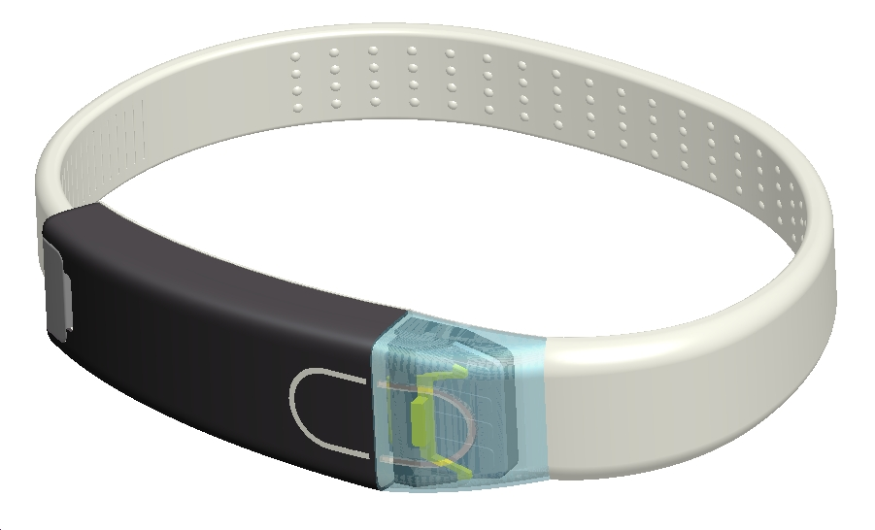
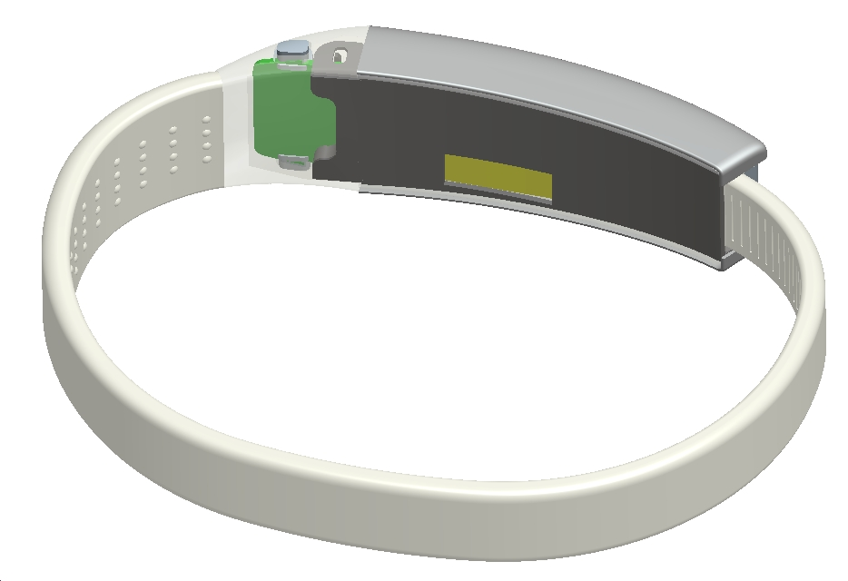
DETAILS
HOLE IN THE METAL CHASSIS FOR THE BT ANTENNA
CLIP RELEASE MECHANISM INTEGRATED INTO THE USB COVER

